Slide 1

Azure DBA SQL
Maximiliano Accotto
Microsoft MVP SQL Server desde 2005
Owner Triggerdb Consulting
http://blog.maxiaccotto.com
http://www.triggerdb.com

Slide 2







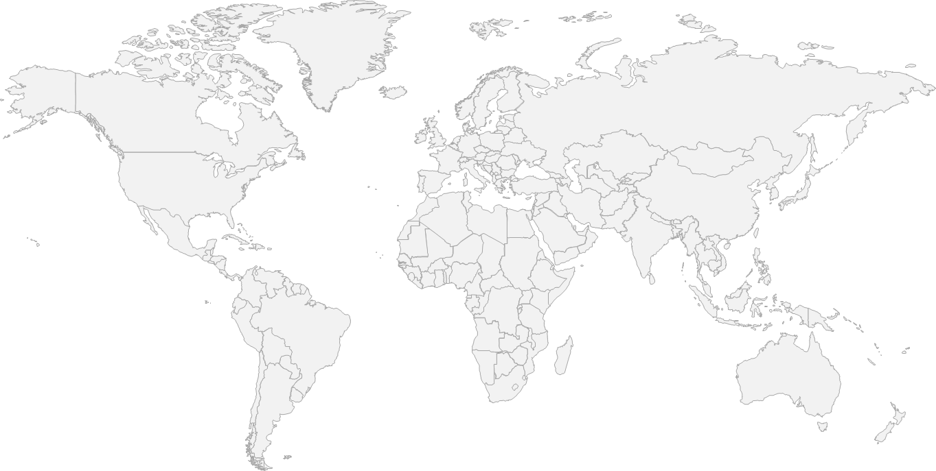
FRAMEWORKS
Caching
Identity
Service Bus
Media
CDN
HD Insight/ Big Data
Commerce
Integration
Analytics
HPC
Mobile
SERVICES
Compute
Storage
Networking
Virtual Machines
Web Sites
Mobile Services
Cloud Services
SQL Database
Tables
Blob Storage
Virtual Network
Traffic Manager
FABRIC
DB
Global Physical Infrastructure
servers/network/datacenters
Automated
Managed Resources
Elastic
Usage Based
INFRASTRUCTURE
1
2
3
N Central US, S Central US, W US, E US, N Europe, W Europe, E Asia, SE Asia + 24 Edge CDN Locations

Slide 3

Windows Azure Data Management — Overview
NON-RELATIONAL
RELATIONAL
0100110100101010100101000111010100100101
Blob Storage
Tables
HDInsight
SQL Server in a VM
SQL Database
A cloud storage service offering the simplest way to store large amounts of unstructured text or binary data, such as video, audio and images, and for creating virtual hard drives in the cloud.
A NoSQL key/value store that provides simple access to semi-structured data at a lower cost for applications that do not need robust querying capabilities
A Big Data implementation 100% compatible with Apache Hadoop.
A full-featured instance of SQL Server running in a Windows Azure Virtual Machine for quickly and easily running or testing SQL Server applications in the cloud
A feature-rich, fully managed relational database service that offers a highly productive experience with business-ready capabilities built on SQL Server technology
Best for inexpensive, scalable storage of data
Best for inexpensive, scalable storage of semi-structured data
Best for Big Data Analytics across semi-structured and unstructured data
Best for existing and new applications needing full SQL Server feature set
Best for new cloud applications needing relational capabilities and high availability

Slide 4
Options for Relational Data Services in the Cloud
INFRASTRUCTURE AS A SERVICE (IaaS)
PLATFORM AS A SERVICE (PaaS)
SQL Server in a Windows Azure Virtual Machine
Windows Azure SQL Database
DB
Full Control & Flexibility
Simplified Administration
Highly Customized Environment
Eliminate Hardware Costs
Decrease Time to Market
Fully Managed Service
Eliminate Hardware & Administrative Costs
Build Modern Apps

Slide 5
Options for Relational Data Services in the Cloud
INFRASTRUCTURE AS A SERVICE (IaaS)
PLATFORM AS A SERVICE (PaaS)
SQL Server in a Windows Azure Virtual Machine
Windows Azure SQL Database
DB
Full Control & Flexibility
Simplified Administration
Move Existing Apps
Development & Test
Hybrid HA & Disaster Recovery
Cloud-designed Business Apps
Websites & Mobile Apps
Extend On-Premises Apps

Slide 6



SQL Server in a Windows Azure Virtual Machine
Low TCO for Existing Apps
Full SQL Server Capability
Flexibility & Control
Managed Infrastructure
No App Changes Required
Familiar Development tools
Library of VM Templates
High Availability of Database with AlwaysOn Availability Groups
Advanced Security (Transparent data encryption & auditing)
Full Business Intelligence Functionality
Full Control of Virtual Machine
Common Identity (Active Directory Integration)
Fully Managed Infrastructure
99.95% SLA for Virtual Machine
Single Pane of Glass to Manage with System Center 2012

Slide 7
Develop & Test New Apps
SQL Serve in a Windows Azure VM
Leverage consistent tools, with SQL Server Management Studio & SQL Server Data Tools
TEST
Spin up VMs in minutes with a gallery of ready-to-use images at your fingertips
Virtual Machine
Develop
Deploy
Save money by shutting down development and testing VMs when not in use
SQL Server Data Tools
On-Prem

Slide 8

Hybrid HA & Disaster Recovery
SQL Serve in a Windows Azure VM
Remove the costs of licensing & maintaining HA secondaries
Windows Azure Virtual Machine
SQL Server AlwaysOn Secondaries
Leverage cloud benefits for scale and high availability of secondaries
APPLICATION
Streamline HA setup and reduce downtime in the case of on-premises failure
SQL Server AlwaysOn Primary, On-premises
On-Prem

Slide 9
Azure SQL Database & SQL Server in Azure VM
SQL Server in Azure VM
Azure SQL Database
You access a VM with SQL Server
You manage SQL Server and Windows: High Availability, Backups, Patching
Full on-premise compatibility
Different VM sizes: A0 (1 core, 1GB mem, 1TB) to A16 (16 cores, 112GB mem, 16TB)
VM availability SLA: 99.95%: Can achieve higher availability (~99.99%) configuring AlwaysOn
Reuse on-premise infrastructure (e.g. Active Directory)
You can run any SQL Server version and edition
You access a DB
DB is fully managed: High Availability, Backups, Patching
Runs latest SQL Server version, based on Enterprise edition
Incomplete on-premise compatibility (e.g. no jobs, linked servers, FileStream)
Different DB sizes: Basic (2GB, 5tps) to Premium (500GB, 735tps)
DB availability SLA: 99.99%
Migrate existing apps
A few SQL Servers
Build new apps
Tens to hundreds of DBs

Slide 10
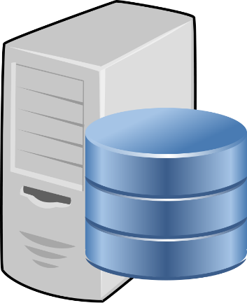

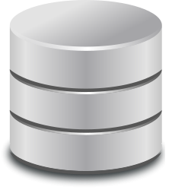


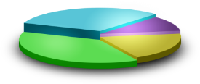
SQL Server on-premise using cloud resources
Backup to Azure Storage
Optionally Managed
On Premise
Data Files in Azure Storage
Microsoft Azure
Azure Storage
AlwaysOn
Replica in Azure VM
Primary
Secondary

Slide 11
Backup to Windows Azure
What’s being delivered
SQL Server supports backups to and restores from the Windows Azure Blob storage service (UI, T-SQL, PowerShell commandlets)
Main benefit: Take advantage of Windows Azure Blob storage
Flexible, reliable (3-copies geo-DR), and limitless off-site storage
No need of backup media management
No overhead of hardware management
CREATE CREDENTIAL mystoragecred
WITH IDENTITY = ‘mystorage',
SECRET = ‘<your storage access key>
BACKUP DATABASE mydb TO URL ='https://mystorage.blob.core.windows.net/backup-container/mydb-20130411.bak'
WITH CREDENTIAL = ‘mystoragecred', FORMAT, COMPRESSION, STATS = 5,
MEDIANAME = ‘mydb backup 20130411', MEDIADESCRIPTION = 'Backup of mydb'

Slide 12

Backup to Windows Azure
Windows Azure VM
Windows Azure storage
On-premises server
On-site/off-site storage costs
Device management costs
Windows Azure Blobs
Box
Near “bottomless” storage
Off-site, geo-redundant
No provisioning
No device management
Media safety (decay-free)
Remote accessibility
WA
XDrives limited to 1 terabyte
Max 16 drives
Manage drives and policy
Notes:
You can use the Transact-SQL ALTER TABLE...SWITCH statement to quickly and efficiently transfer subsets of your data in the following ways:
Assigning a table as a partition to an already existing partitioned table.
Switching a partition from one partitioned table to another.
Reassigning a partition to form a single table.

Slide 13
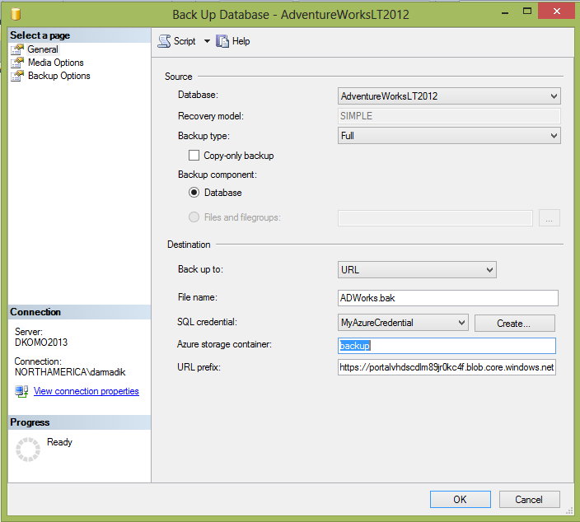
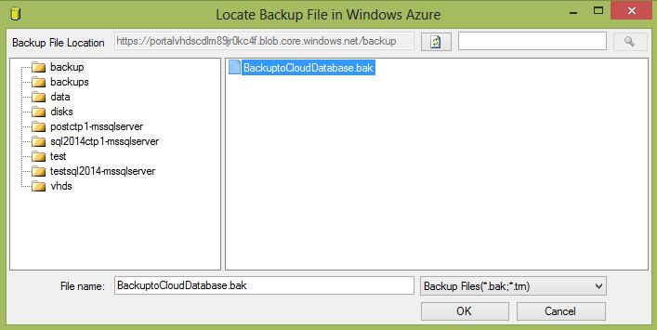
Backup to Windows Azure
Simple configuration UI
Easy creation of Azure credential
No overhead
Restore GUI
Backup GUI

Slide 14
Predictable Performance
Web / Business
Basic / Standard / Premium
Machine
Machine
Compute
Compute
DB 1
DB 2
DB 3
Noisy neighbor!
DB 2
DB 2
DB 3
DB 1
DB 3
DB 1
DB 5
DB 5
DB 6
DB 4
DB 4
DB 6
DB 4
DB 5
DB 6
Writes
Reads
Writes
Reads
DB 9
Bounding boxes eliminates noisy neighbors
DB 9
DB 7
DB 8
DB 9
DB 7
DB 8
DB 7
DB 8
Memory
Memory

Slide 15
Database Throughput Unit – DTU
Bounding Box
Monitoring
% of current Performance Level
Compute
Utilization
DB workload
Writes
Reads
75%
50%
50%
60%
Read
Write
CPU
Memory
Memory
Represents the relative power (resources) assigned to the database
Blended measure of CPU, memory, and read and write rates
Compare the power across performance levels
Simplifies talking about performance, think IOPS vs. %

Slide 16
Azure SQL Database Benchmark – ASDB
An example representing meaningful OLTP-workload
Uses six tables of varying sizes some of which are always larger than available memory and scale with the throughput
Uses nine transaction types
A transaction is a combination of multiple SELECT, DELETE, INSERT, UPDATE statements

Slide 17
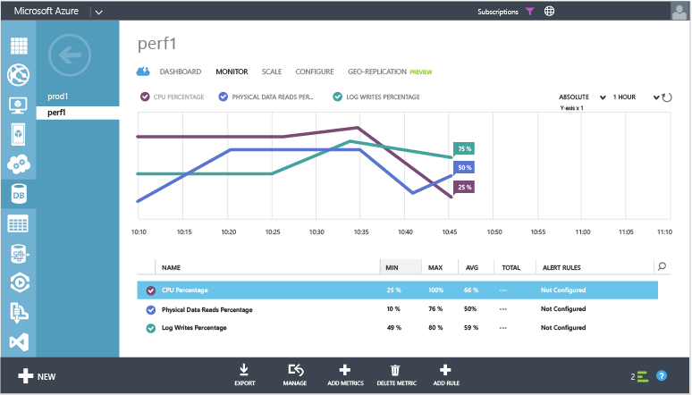
Resource Monitoring
master.sys.resource_stats
Based on 5 minute averages
userdb.sys.dm_db_resource_stats
Based on 15 second averages
Percentages relative to performance level
Accessible though Azure Portal
Allows to configure alerting!

Slide 18
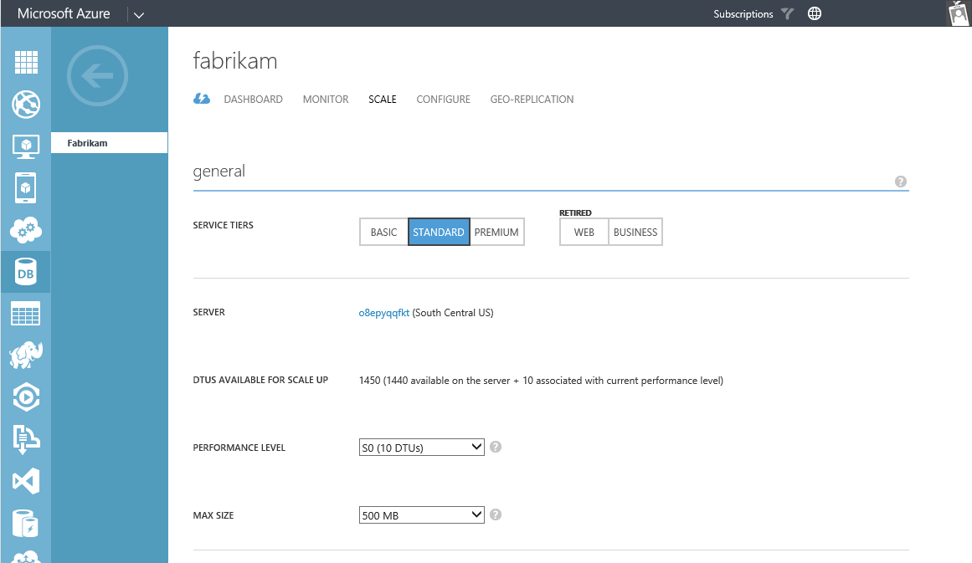
Changing Performance Level
PowerShell
Set-AzureSqlDatabase
REST
Update Database / ServiceLevelObjectiveId
.NET
Microsoft.WindowsAzure.Management.Sql. SqlManagementClient
client.Databases.Update(…)
T-SQL
ALTER DATABASE … MODIFY (EDITION = …)

Slide 19
Azure SQL Database Service Tiers
Basic
Standard
Premium
Intended Use
Light transactional loads
Go-to option for most business applications
High throughput and business-critical databases
Availability
99.99%*
Size
2 GB
250 GB
500 GB
Performance
•
••
•••
Business Continuity
•
••
•••
Incremental performance and features with easy upgrade and downgrade
*The 99.99% availability SLA does not apply to Web and Business editions, which continue to be supported at 99.9% availability.

Slide 20
Data Protection
Automatic, continuous backups
Retention varies by service tier: Basic 7 days, Standard 14 days, Premium 35 days
Daily backups also copied to a remote datacenter
“Oops” recovery
Self-service point-in-time restore from local backups, including deleted databases
Data center disaster
Self-service restore from remote backups to any region at any time
No charge for backups, normal database rates apply for restored databases
Basic, Standard & Premium databases are protected from accidental data corruption, deletion & disaster

Slide 21

Asynchronous Geo-replication
Standard geo-replication (Standard and Premium)
Optional non-readable secondary in paired region
Secondary database is charged at discounted rate
Failover enabled by Microsoft if disaster occurs
Active geo-replication (Premium)
Up to 4 readable secondaries
Full control over secondary location and failover
Supports load balancing, application upgrade and relocation scenarios
Can be combined with a non-readable secondary
DB1
DB1
DB1
DB1
DB1
Geo-replication minimizes business interruption from possible disasters

Slide 22
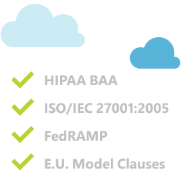
Compliant and Secure
SQL Database platform is verified compliant as part of Azure certification
HIPAA BAA
ISO/IEC 27001 2005
FedRAMP
E.U. Model Clauses
You are still responsible for several aspects of security, e.g.
Use secure client connections
Configure firewalls to restrict IP ranges
Use least privilege
Protect against SQL injection
Compliant and secure when configured and used responsibly

Slide 23
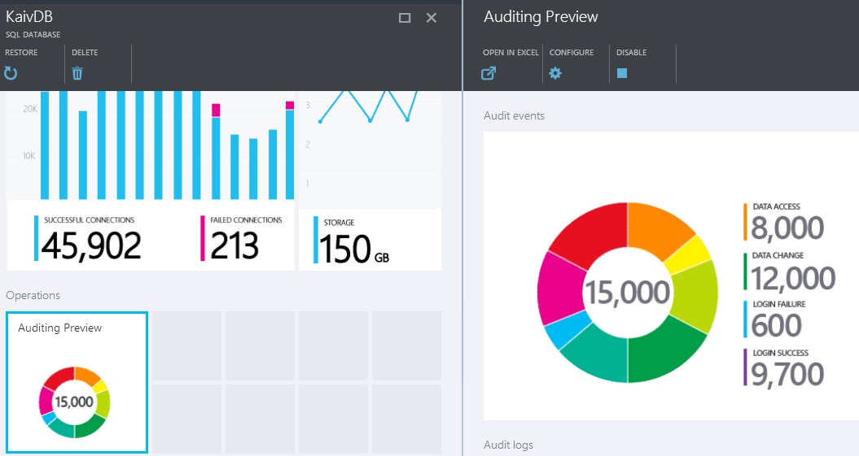
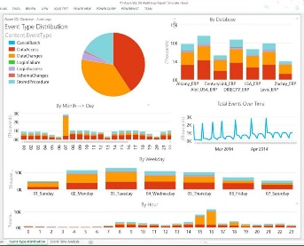
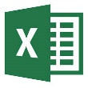



Auditing ^{PREVIEW}
Audit
log
Azure Storage
Auditing
Configurable to track & log database activity, managed via portal or APIs
Audit logs reside in your Azure Storage account
Dashboard views in the portal provide insights at a glance
Interactive & customizable analysis with Power View and Power Pivot
Available in Basic, Standard, and Premium via the new Azure preview portal
SQL Database
Auditing enhances compliance & security and provides operational insights

Slide 24
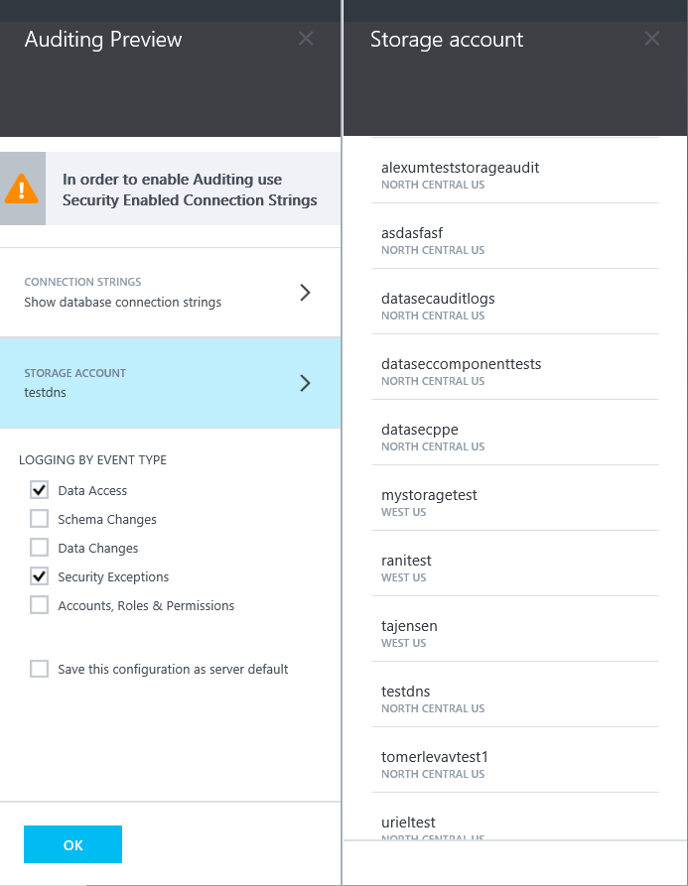
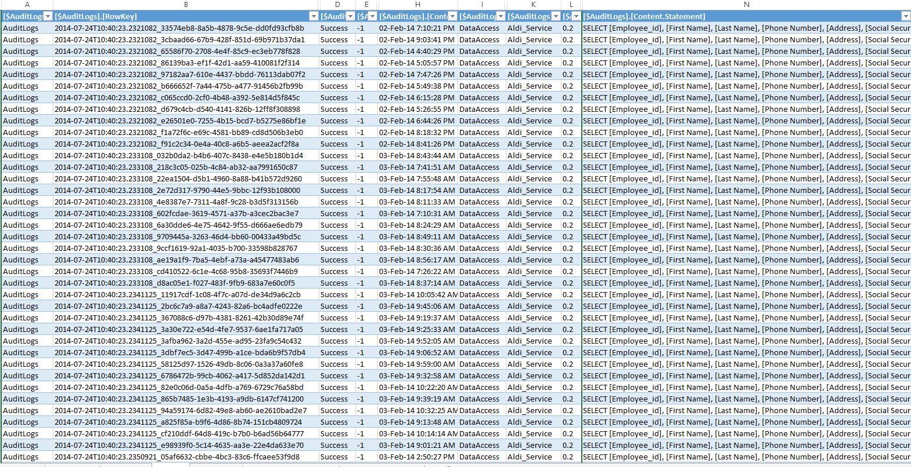
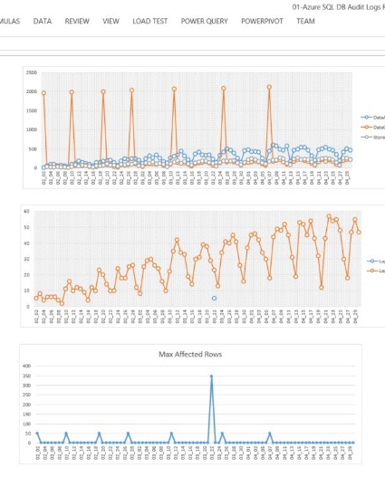
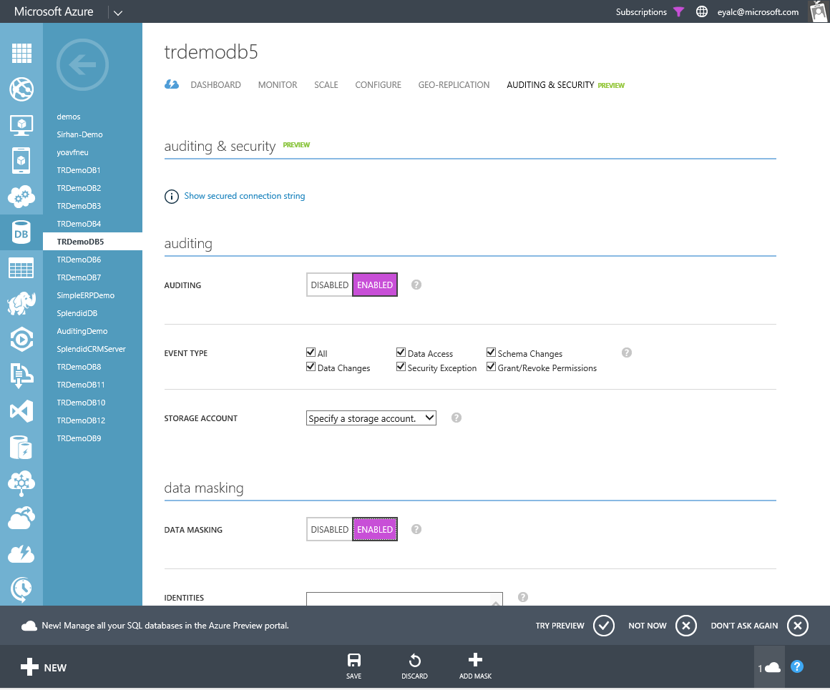
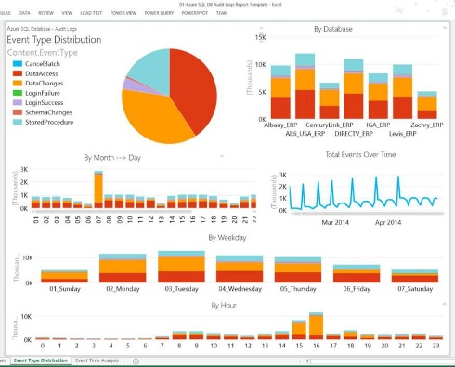
Auditing - Overview
Where to start?
Retain
Report
Insights

Slide 25
New Auditing Feature in Azure SQL DB
Configurable to track & log database activity
Dashboard views in the portal for at-a-glance insights
Interactive & customizable Power View and Power Pivot reports for deep analysis on Audit log data
Audit logs reside in your Azure Storage account
Available in Basic, Standard, and Premium
Audit
log
Azure Storage
Auditing
SQL Database
Application data

Slide 26
Setting up Auditing
Server Default
Per DB
Server
Server
DB1
DB1
DB Policy
*-------
*-------
Default Policy
*-------
*-------
*-------
*-------
Azure Table
Azure Table
DB2
DB2
DB Policy
*-------
*-------
DB3
DB3
DB Policy
*-------
*-------
Combination of the two…

Slide 27
Gracias

Slide 28
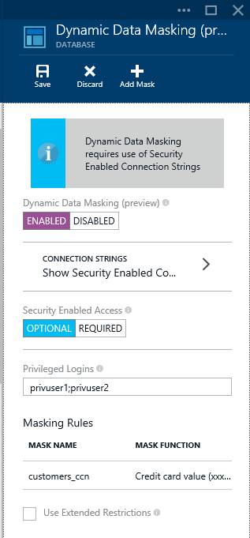
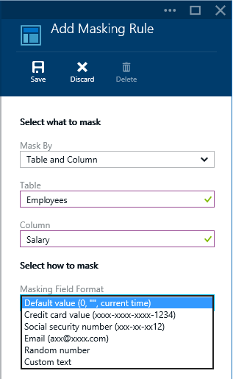
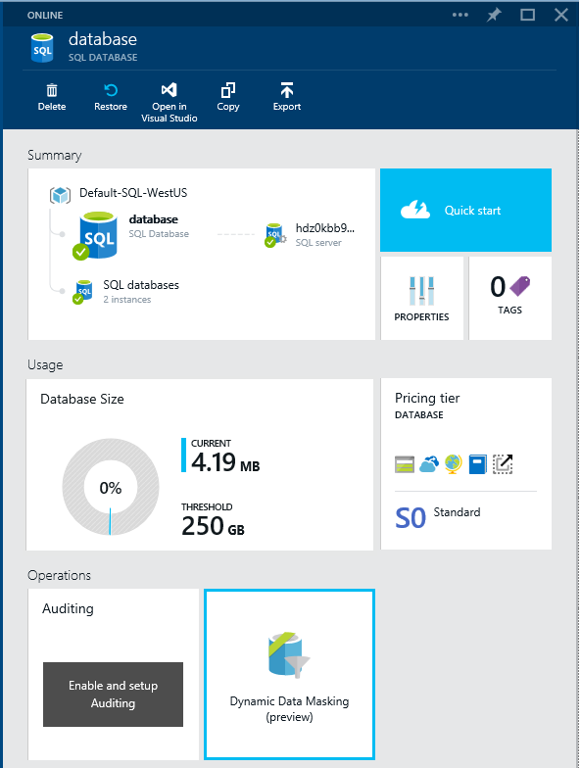
Data Masking

Slide 29
Gracias

Slide 30
Gracias

